Slide 1
NCUC Africa Members First Regional Webinar
Ines Hfaiedh
Africa Representative in NCUC Executive Committe
Monday, October 02nd 2017

Slide 2
Where is NCUC in ICANN Governance System?
We are a constituency
Our Stakeholder Group is Noncommercial Stakeholder Group (NCSG).
We contribute to ICANN policy through various ways, mainly:
Policy statements
Policy making groups
Run for elections to become Councilors at the Generic Name Supporting Organization (GNSO) Council.

Slide 3
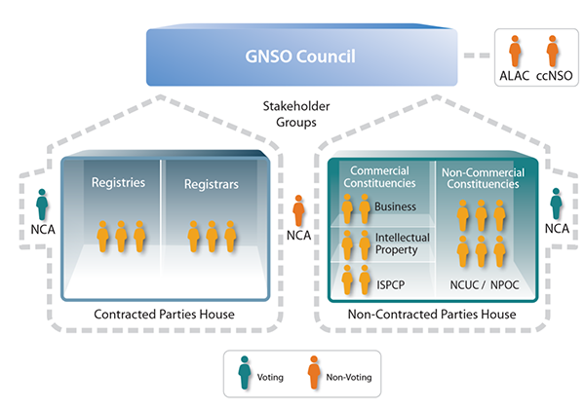
Find NCUC

Slide 4
African Regional Perspective
How can NCUC address African noncommercial users rights in domain space?

Slide 5
African DNS Market Study: Issues (10th March 2017)
Methodology:
“A response rate of 22% was received (a total of 308 questionnaires were completed by 209 targeted respondents”.
2. The African Ecosystem
- Access: Africa is lagging behind other regions in relation to Internet access with an average penetration of 28.7% compared to a world average of 50.1%
- Lack of infrastructure
Focused on big cities
High access costs
Lack of local content, ie, in African languages.
very small number of ICANN accredited Registrars.
https://www.icann.org/en/system/files/files/africa-dns-market-study-final-06jun17-en.pdf

Slide 6
How can NCUC help address those Africa DNS Issues? Te p
Making policies related to generic domain names by advancing these principles:
Freedom of Expression/ Access to Knowledge
Privacy and Data Protection
Human Rights
Discuss Internet Governance
Development

Slide 7
Topics NCUC Works on
Access to knowledge/Freedom of Expression and trademarks
Tension between freedom of expression and trademark rights
Example:
When people want to register what somebody else considers their trademark in a domain name.
The domain name might be used in ways that have nothing to do with the trademark.
Yet, trademark owners of course want to protect their marks.

Slide 8
Seeking balance in domain policy and dispute resolution: Particularly through the development of the Uniform Domain Name Resolution process (UDRP), the Uniform Rapid Suspension policy (URS), and the new gTLD program.
Example:
Domain name registrants in the region usually suffer from lack of having an effective dispute resolution mechanism in place.
Intellectual Property Rights overreach that tends to exclude others
OR Intellectual Property lacks enough safeguards like enforced laws

Slide 9
Privacy, ICANN and WHOIS
Concern - treatment of registrant data (those that register www.example.com )
You can recommend privacy protections
You can engage with discussions on data protection regulations

Slide 10
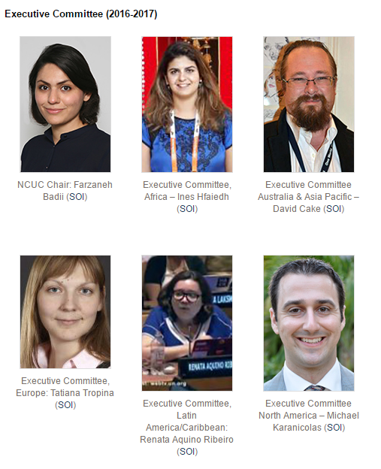
Executive Committee and Points of contact

Slide 11
Thank You!
Website: http://www.ncuc.org/
Twitter: @NCUC
Contact: ncuc@ncuc.org
Join: http://www.ncuc.org/join
Notes:
NCUC Issues
* Protecting Noncommercial Uses and Users -- seek to ensure commercial interests do not override the interests of nonprofits and ordinary users
* Diversity and Consumer Choice -- support a competitive domain name industry that offers Internet users innovation, quality options and affordable prices
* Human Rights -- promote an approach to domain name policy that is consistent with internationally recognized human rights
* Freedom of Expression -- challenge efforts to abuse the core of the Internet by censoring expression and regulating content
* Privacy -- oppose efforts to use domain registration records for indiscriminate surveillance
* Access to Knowledge -- advocate for protection of the global public sphere against the excessive application of intellectual property restrictions
* Development -- work for policies that promote socio- economic growth and development in all areas of the world
* Multilingual Internet -- support standards and practices that allow all cultures and linguistic groups to be represented in the domain name space
* Global Internet Governance -- We strive to make governance institutions accountable, promote multistakeholder participation

