Slide 1
Writing for Policy
and
Public Comment

Slide 2
“Decisions at ICANN are made by people who show up. People who scream most loudly.” - Kathy Kleinman

Slide 3
Communicate Effectively
Speaking
Listening
Writing

Slide 4
Communicate Effectively
Verbally communicate ideas
Listen and comprehend
Summarize in writing

Slide 5
Public Comment Process
Most effective way for members to participate in ICANN policy development

Slide 6
Writing for Public Comment
Prepare members to collaborate towards developing a succinct, coherent response to issues raised during a Policy Development Process

Slide 7
Writing for Public Comment
How prepared are members to collaborate?
How many have collaborated previously?
What qualities and skills are required of the “penholder”?

Slide 8
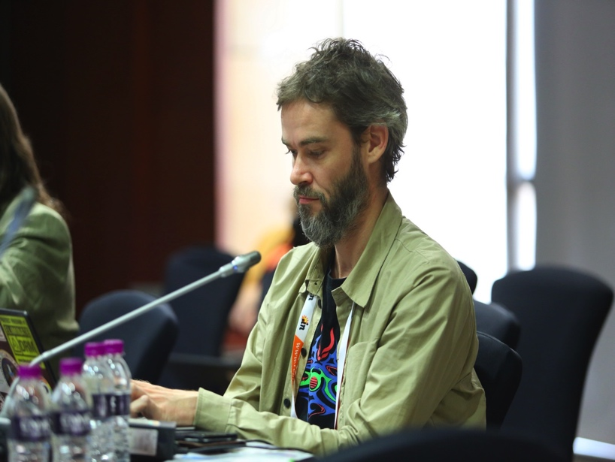
Reasons You Write
Developing writing skills develops confidence
Broadens pool of contributors
Diversity and new ideas
Stronger voice

Slide 9
Reasons You Write
Opportunity to build NCUC through constituent feedback
Share diverse opinions as first step towards collaboration

Slide 10
Reasons You Write
Opportunity to engage outside of ICANN as a member of ICANN community

Slide 11
Writing for Public Comment

Slide 12
Writing for Public Comment
Vast differences in:
Thought Process
Structure
Clarity
Message delivery
Effectiveness

Slide 13
“Others inspire us, information feeds us, practice improves our performance, but we need quiet time to figure things out, to emerge with new discoveries, to unearth original answers.” – Ester Buchholz

Slide 14
Plan Your Comment
Identify the issue
Determine specific areas of concern
Limit your concerns

Slide 15
“Do only what is necessary to convey what is essential. Carefully eliminate elements that distract from the essential whole, elements that obstruct and obscure…

Slide 16
…clutter, bulk, and erudition confuse perception and stifle comprehension, whereas simplicity allows clear and direct attention.” - Richard Powell

Slide 17
Plan Your Comment
Develop your reasoning, research support for your claims and evidence
Determine how your position would make the policy better
Reach consensus on the message

Slide 18
Structure Your Comment
Address specific group or individual
State the issue and your position on it
Explain why your constituency is uniquely qualified to comment

Slide 19
Structure Your Comment
Describe how your constituents would be affected
Suggest your alternative
Explain how your position improves the policy
Close with a compelling summary and a Call to Action

Slide 20
Write Your Comment
Remember
Be Respectful
Be Direct
Be Brief
Be Convincing

Slide 21
Write Your Comment
Paragraph #1
Identify yourself and state the policy at hand
Recognize the work of volunteers

Slide 22
Write Your Comment
Paragraph #2
Support your objection with reason and evidence
Explain why you or your constituency is qualified to comment on this issue

Slide 23
Write Your Comment
Paragraph #3
Connect to the people you represent
How will they be affected?
Distinguish your comment from others

Slide 24
Write Your Comment
Paragraph #4
Propose your alternative solution with a Plan of Action
List key indicators of success
Present a timeline to monitor success

Slide 25
Write Your Comment
Paragraph #5
Be compelling in your summation
Express appreciation to the policy makers
Urge a Call to Action on your alternative solution

Slide 26
Writing for Policy
and
Public Comment

